Slide 1

Deep Water
Avkash Chauhan (avkash@h2o.ai)

Slide 2
Deep Learning Introduction

Slide 3
Terminology
A Neural Network is collection of n-number of neurons interconnect with each other in a linear way. Each neuron has weight and bias.
A deep neural network (DNN) is an artificial neural network (ANN) with multiple hidden layers of units between the input and output layers.
Notes:
https://getpocket.com/a/read/1596101568

Slide 4
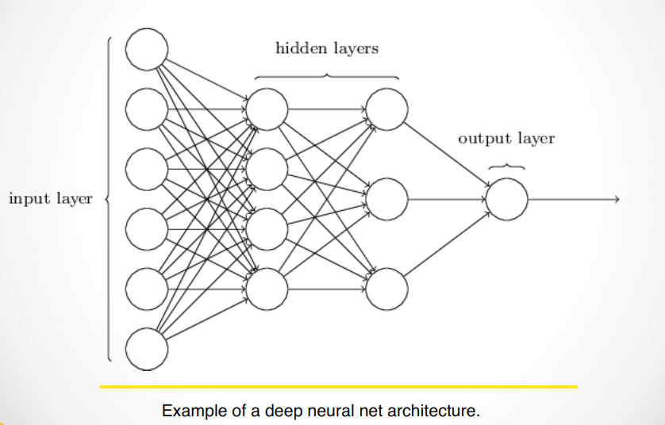
An example “Deep” Neural Network

Slide 5
Terminology
A perceptron is a binary classifier to decide if the input belong to specific class or now
Single layer perceptron has no hidden layer
A multilayer perceptron has 1 more hidden layers and back propagation methods are used
Notes:
https://getpocket.com/a/read/1596101568

Slide 6
Terminology
Input – The regular input
Weight – The importance of each input
Bias – The affinity towards certain output. It allows shift in activation function to the left or right.
Output – The result
Hidden layer: A neuron whose output is connected to the inputs of other neurons and is therefor not visible as a network output
Notes:
https://getpocket.com/a/read/1596101568

Slide 7
Terminology
FNN (Feed Forward Networks) - Simple neural network where information moves in only one direction, forward, from the input nodes, through the hidden nodes (if any) and to the output nodes
RNN (Recurrent Neural Networks) – A Neural network with directed cyclic connections between various unit. Great for text, audio processing
Reinforcement learning: Learning by trial-and-error, mainly using rewards or punishments
Notes:
https://getpocket.com/a/read/1596101568

Slide 8
Terminology
CNN (Convolutional Neural Network) – NN with images as input to encode certain properties, add forward functions etc. Best for image analysis.
Back Propagation:
Back propagation is the process in which we try to bring the error (difference in y and y’) down.
Backpropagation has 2 steps:
Feed forward the values
Calculate the error and propagate it back to the earlier layers.
Transfer Learning:
A Method to make CNN more versatile, practical and useful
Notes:
https://getpocket.com/a/read/1596101568

Slide 9
Terminology
Activation functions are mathematical functions which behave very much like valves. Data which makes an activation function turn true marks the neuron as active. We classify an image based on which all neurons in the network got activated.
Neural Networks are fully connected, which means that one neuron layer would pass the entire dataset to the next layer.
Training of a network means passing a lot of images of various classes as inputs. Each of these images is already tagged to one of the classes.
Pooling is nothing other than down sampling of an image.
https://hackernoon.com/supervised-deep-learning-in-image-classification-for-noobs-part-1-9f831b6d430d
Notes:
https://getpocket.com/a/read/1596101568

Slide 10
STRENGTHS AND WEAKNESSES
Strengths
non linear
robust to correlated features
learned features can be extracted
can stop training at any time
can be fine-tuned with more data
great ensemble member
efficient for multi-class problems
world-class at pattern recognition
Weaknesses
slow to train
slow to score
not interpretable
results not fully reproducible
theory not well understood
overfits, needs regularization
many hyper-parameters
expands categorical variables
must impute missing values

Slide 11
Deep Water
Q

Slide 12
Deep Water Platform
Github repository: https://github.com/h2oai/deepwater
GPU system dependencies:
Latest NVIDIA Display driver
CUDA 8
CUDNN 5.1
Backed Supported
Tensorflow
Mxnet
Caffe

Slide 14
Deep Water Architecture

Slide 15
Deep Learning Demo
Q

Slide 16
Image Classification Demo
Ingest data
Scoring Server
Start server
https://github.com/h2oai/steam/tree/master/prediction-service-builder
Build War
curl -X POST \--form mojo=@mojo.zip \--form jar=@h2o-genmodel.jar \--form deepwater=@deepwater-all.jar \localhost:55000/makewar > example.war

Slide 17
Scoring
Scoring Server
Start server
(https://github.com/h2oai/steam/tree/master/prediction-service-builder)
./gradlew jettyRunWar
Build War
curl -X POST \--form mojo=@mojo.zip \--form jar=@h2o-genmodel.jar \--form deepwater=@deepwater-all.jar \localhost:55000/makewar > catdogmouse.war
Run Service:
java -jar jetty-runner-9.3.9.M1.jar --port 55001 CatDogMouse.war
Notes:
avkash@mr-dl8:~/toolkit/github/steam/prediction-service-builder$ ./gradlew jettyRunWar
avkash@mr-dl8:~/toolkit/deepwater-gpu/dw-scoring$ curl -X POST --form mojo=@deepwater_3fb6f411_9f75_442f_897e_5b2bc8c4b680.zip --form jar=@h2o-genmodel.jar --form deepwater=@/home/avkash/toolkit/github/deepwater/build/libs/deepwater-all.jar localhost:55000/makewar > CatDogMouse.war
avkash@mr-dl8:~/toolkit/deepwater-gpu/dw-scoring$ java -jar jetty-runner-9.3.9.M1.jar --port 55001 CatDogMouse.war

Slide 18
Thank you so much
Notes:
Koeidesu

